Slide 1
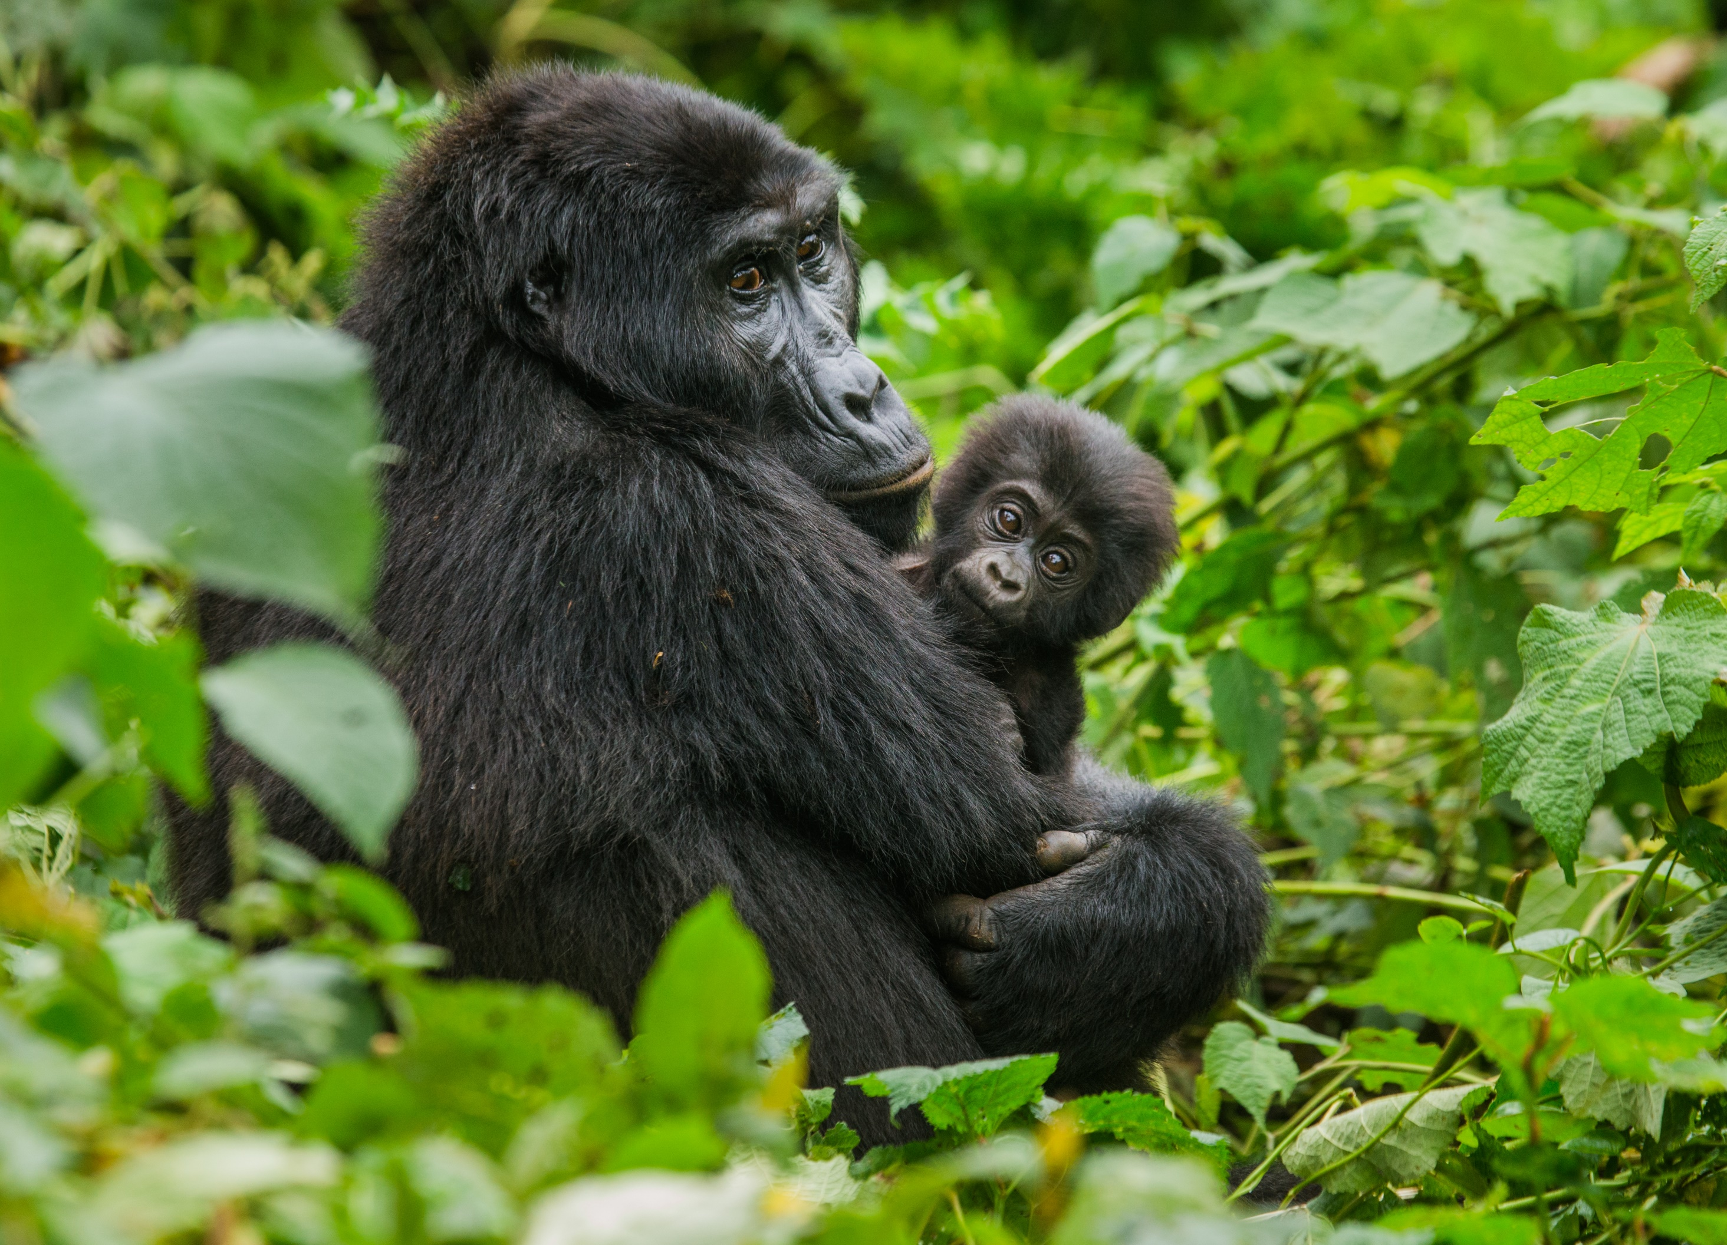


Slide 2

UGANDA – THE PEARL OF AFRICA
Land Linked country in East Africa
Visas are mandatory before departing from the country of residence (no “visa on arrival” at Entebbe)can be obtained at https//immigration.go.ug or through the UG Consulate in Barcelona (see contact details at the last page).
Connectivity: Served by Multiple Airlines; Uganda Airlines, KQ, Emirates, Ethiopian Airlines, Qatar Airways, KLM, Brussels Airlines, and other domestic players.
236,040 sq. km

Slide 3
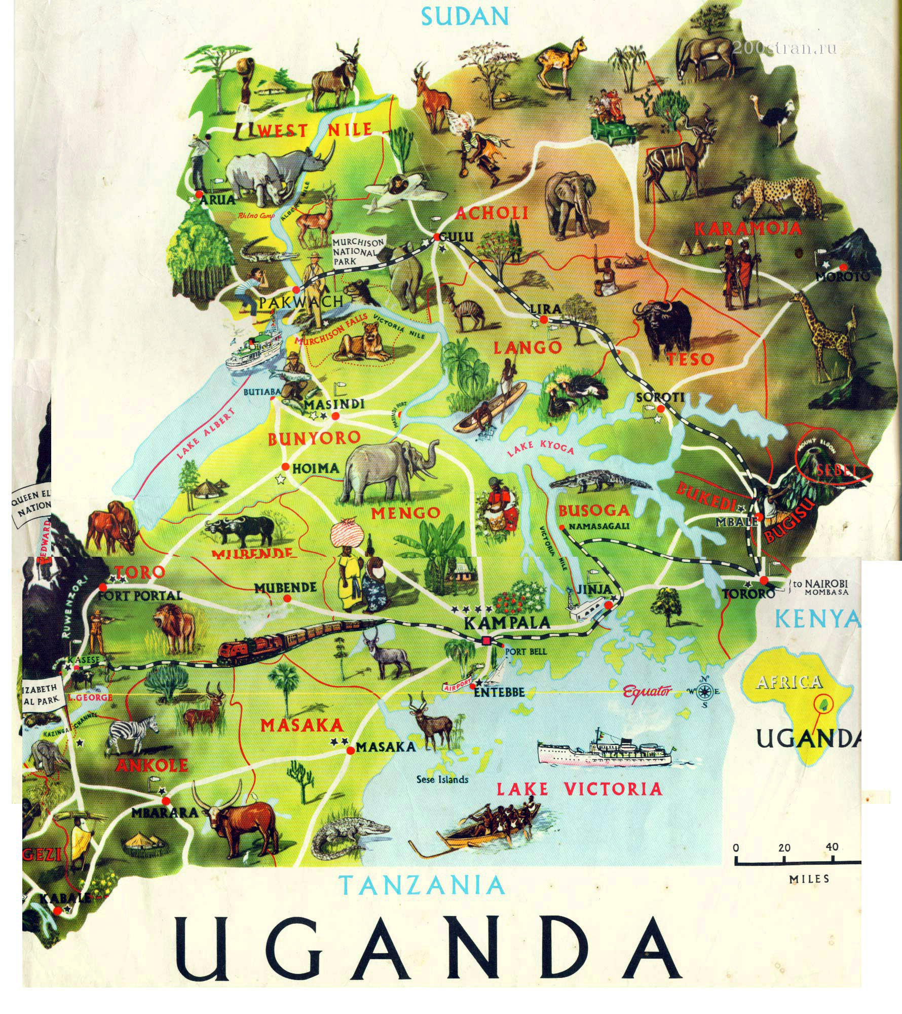


POPULATION
Approx. 48.2 million
CLIMATE
Tropical; generally rainy with two dry seasons (December to February, June to August);
Semi arid in the North East.

Slide 4
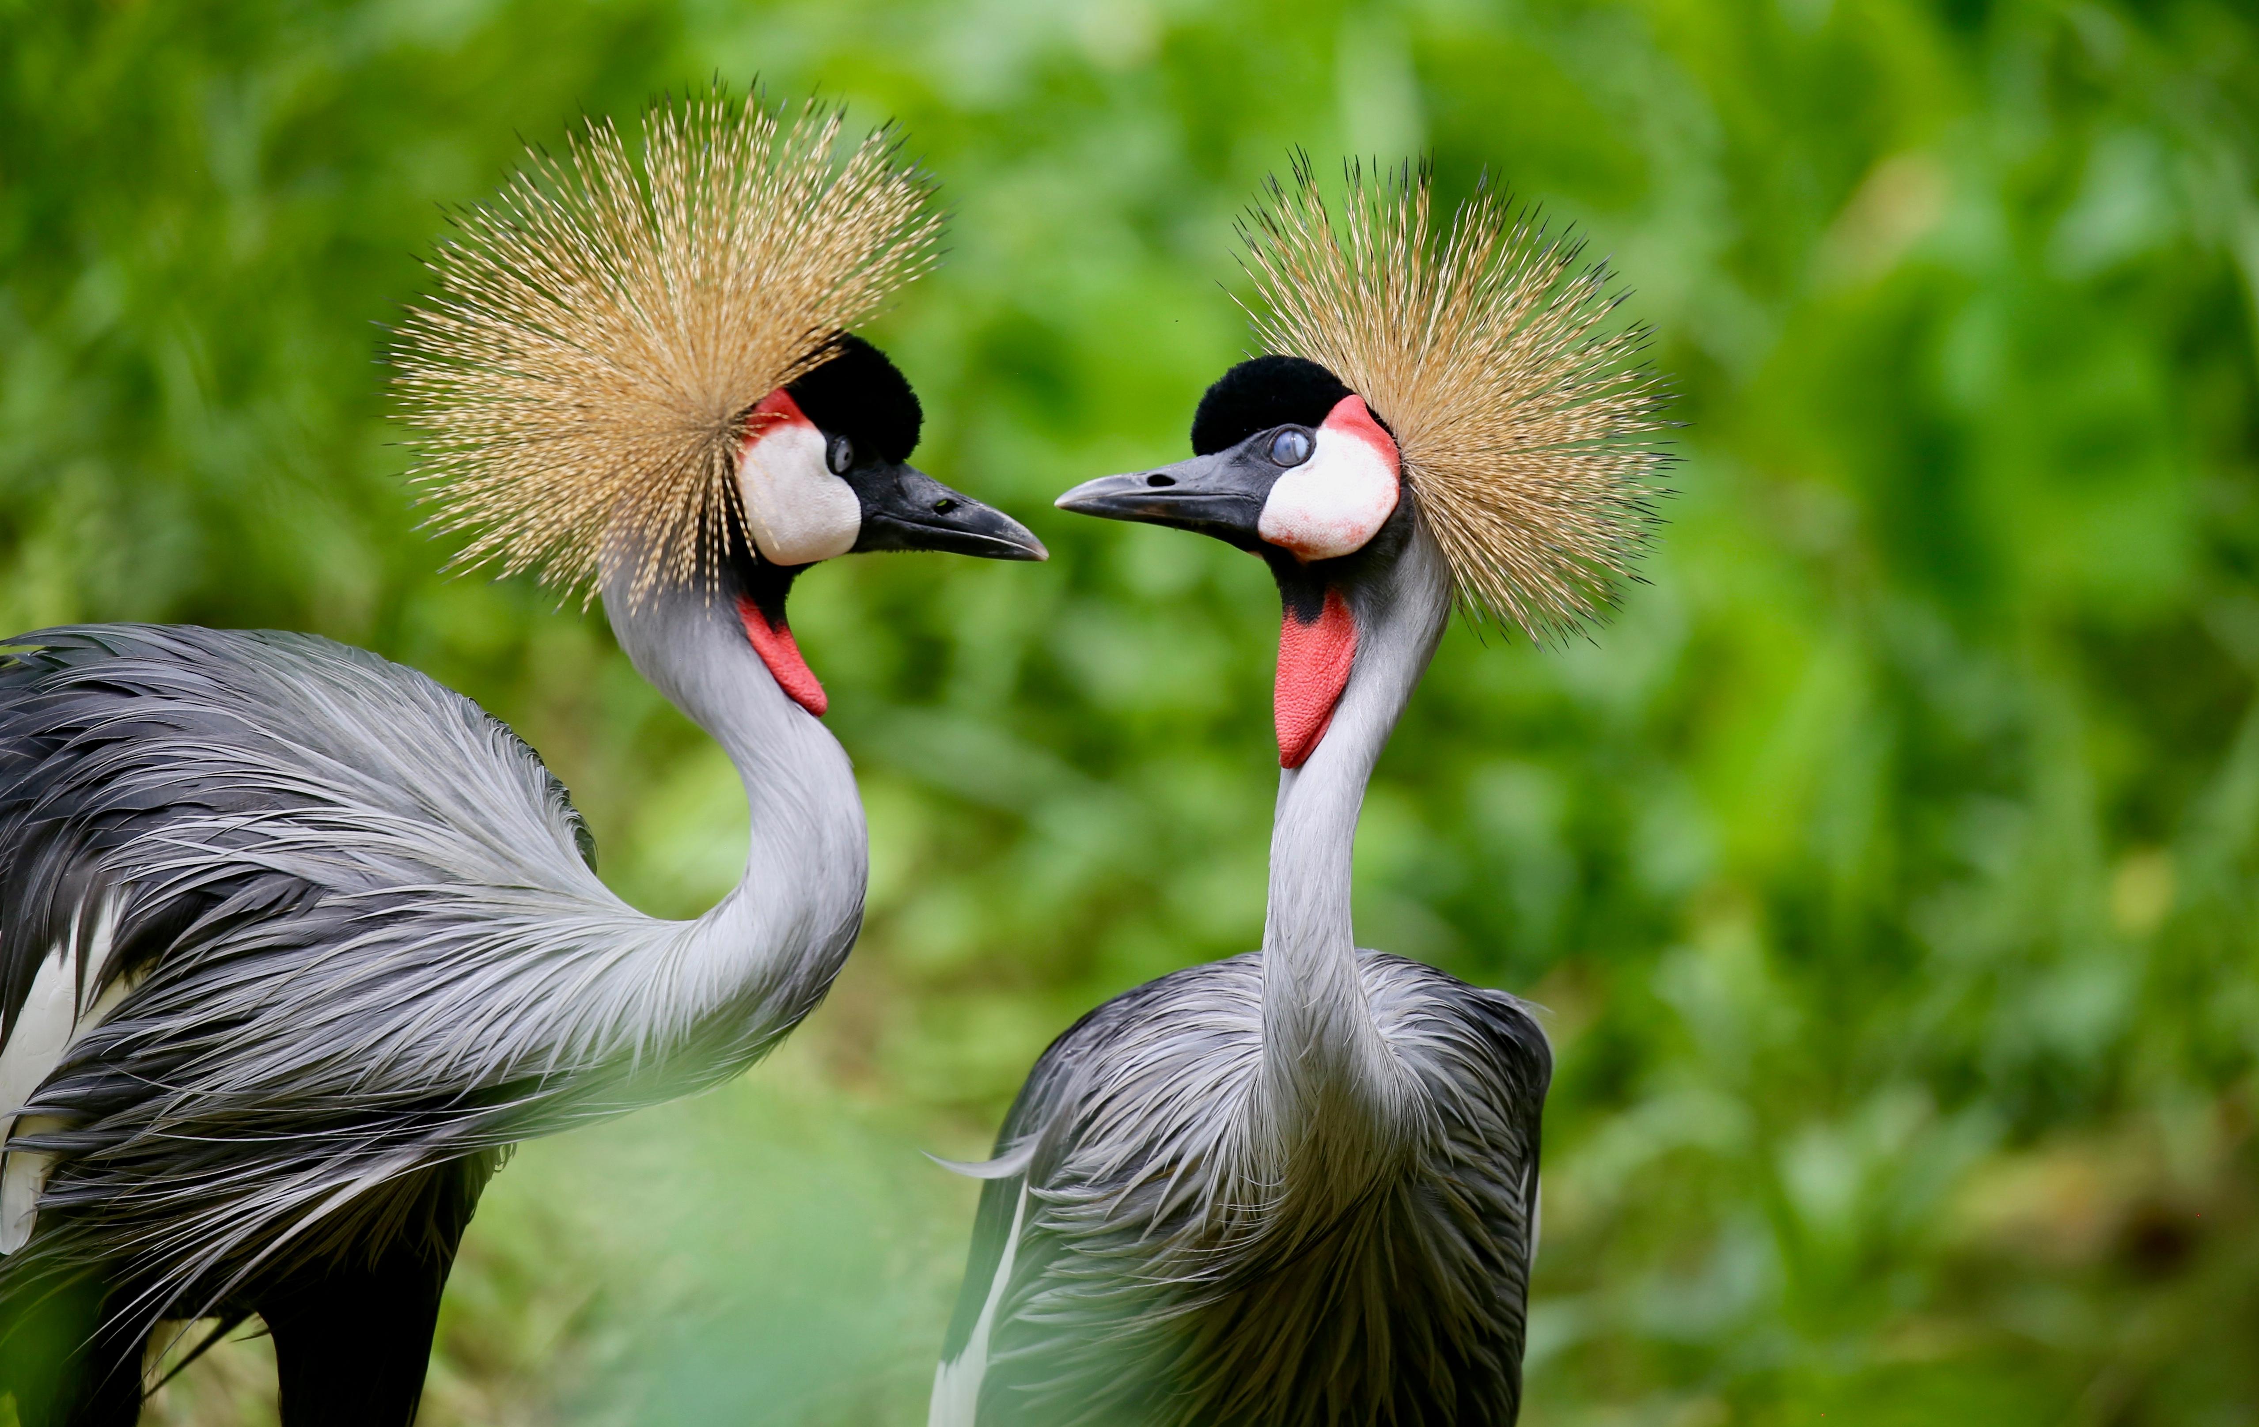
TOURISM
ATTRACTIONS

Slide 5
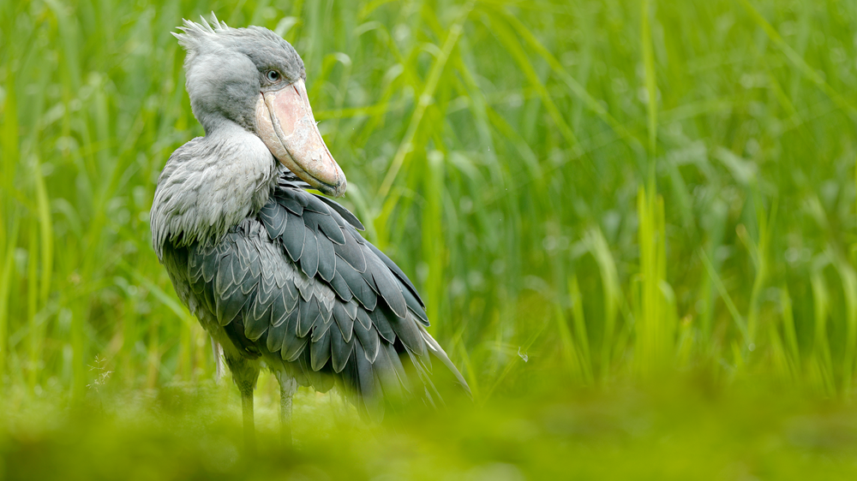

Pristine marine attractions
Home to the source of the world’s longest river, the Nile measuring 6695 kilometers (4184 miles).
Lake Victoria is the world’s second largest fresh-water lake at 68,000 sq. km
Lake Bunyonyi, second deepest lake in Africa 900m.
Twelve(12) wetlands of International Importance designated under the Ramsar Convention (RAMSAR sites)

Slide 6

UNIQUE
MARINE TOURISM
ACTIVITIES

Slide 7
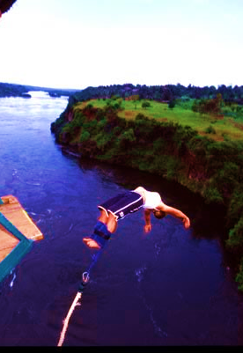
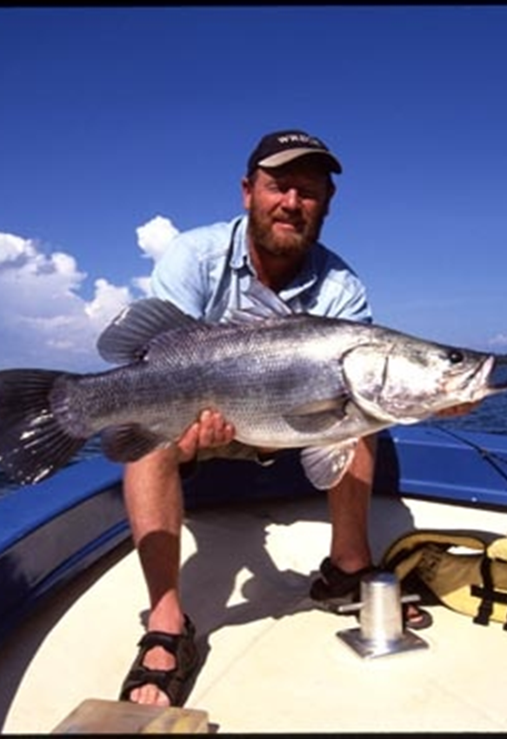
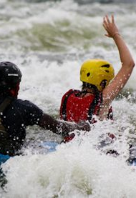
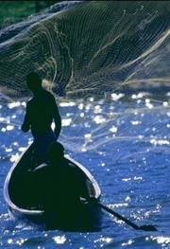
WHITE WATER
RAFTING
CANOEING
BUNGEE JUMPING
SPORT FISHING

Slide 8

DIVERSE WILDLIFE &
GAME
DIVERSE
WILDLIFE

Slide 9
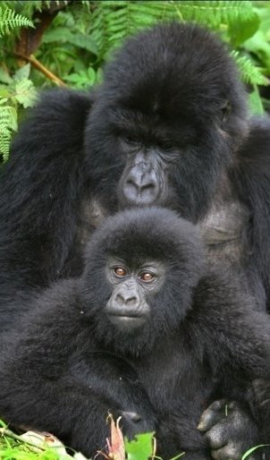
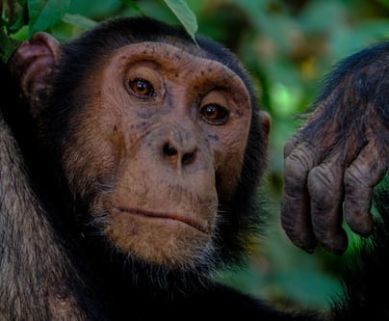
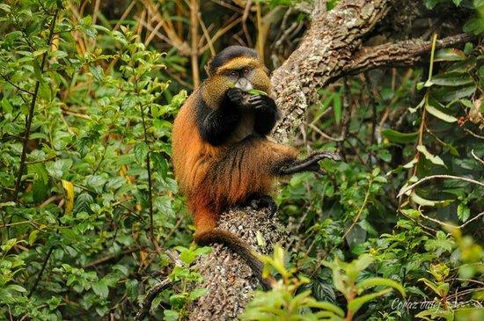
GORILLAS & OTHER PRIMATES
Largest mountain gorilla population in the world (over 400 of them). Less than 700 gorillas survive in the world today.
Over 5,000 chimpanzees (Kibale forest alone holds a population of more than 1,000 chimpanzees).
Other primates include:- monkeys, baboons and nocturnal primates such as Bush babies and Pottos etc.

Slide 10
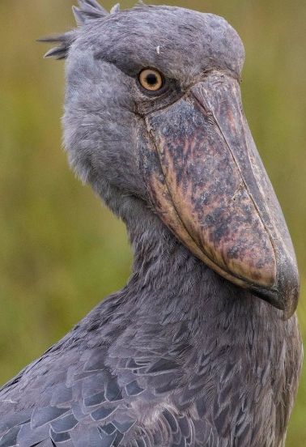

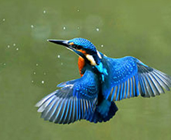
DIVERSITY OF BIRD SPECIES
With more than 1,070 bird species, Uganda is home to over 50% of the entire bird population in Africa.
Queen Elizabeth national park has over 605 species, the largest of any protected area in Africa.
Bwindi Impenetrable National Park was voted Africa’s number one birding site by the African Bird club.

Slide 11
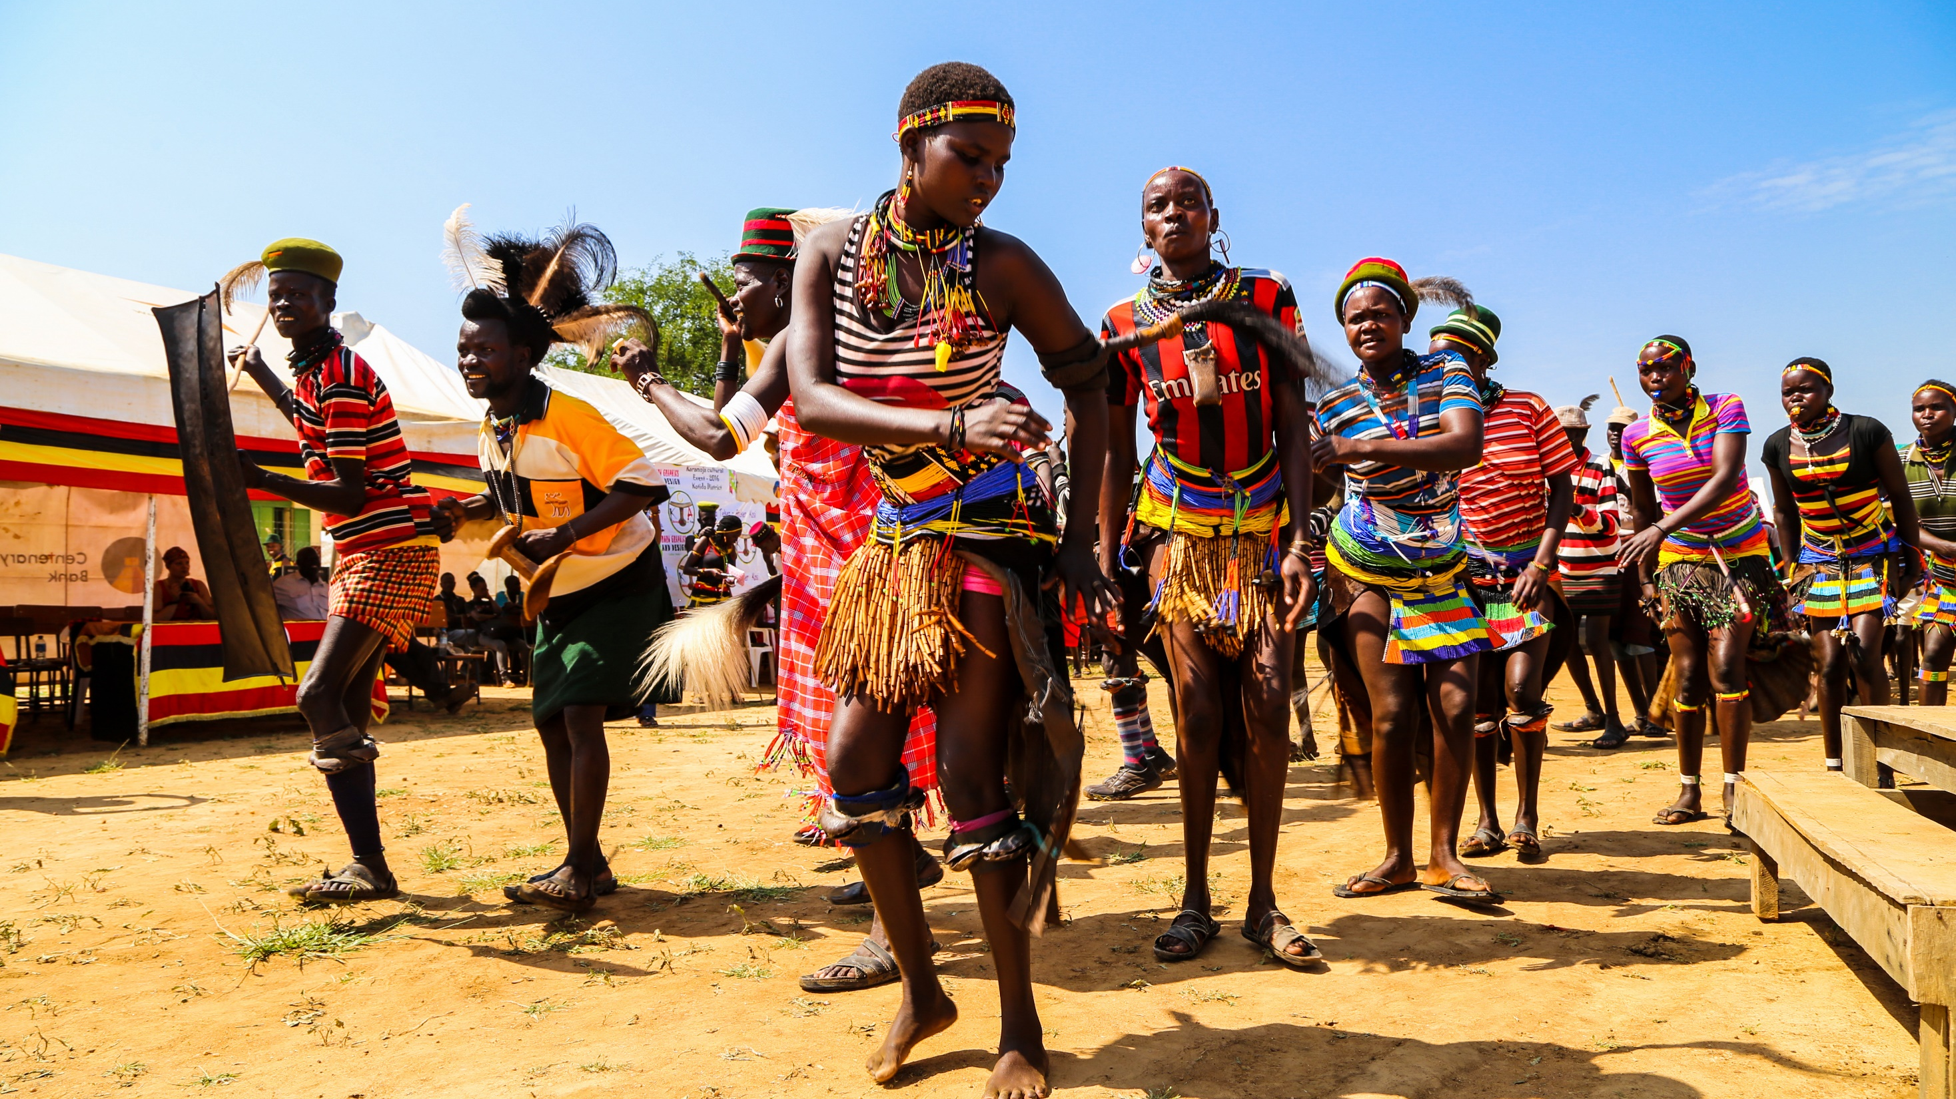
DIVERSE WILDLIFE &
GAME
DIVERSE
CULTURE &
HERITAGE
DIVERSE
CULTURE &
HERITAGE

Slide 12
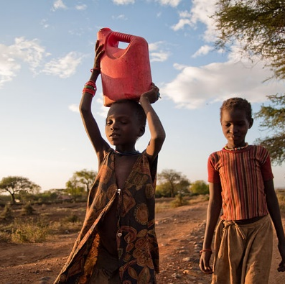
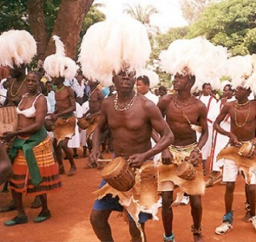
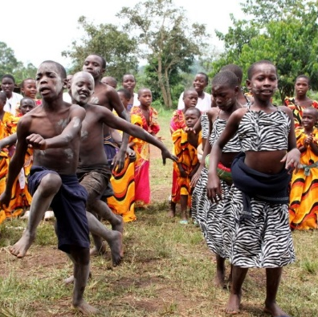
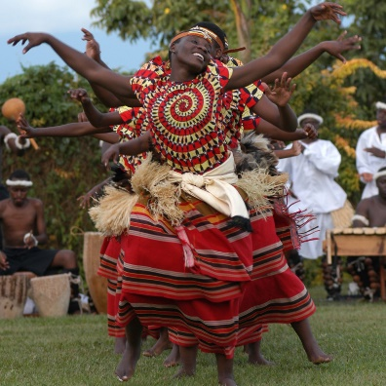
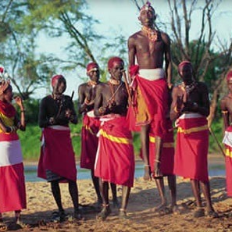
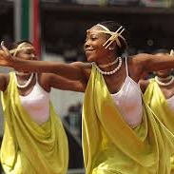
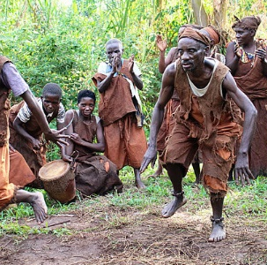
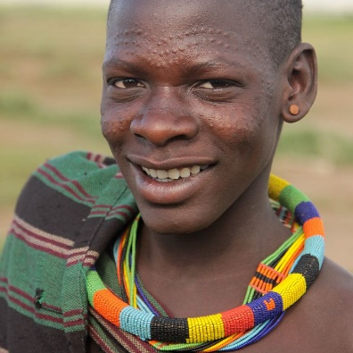
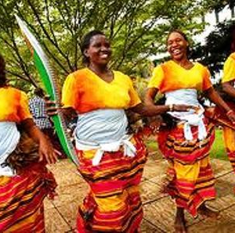

RICH CULTURAL DIVERSITY
Over 56 tribes
Acholi
Baganda
Bagwere
Batwa
Karimojong
….

Slide 13
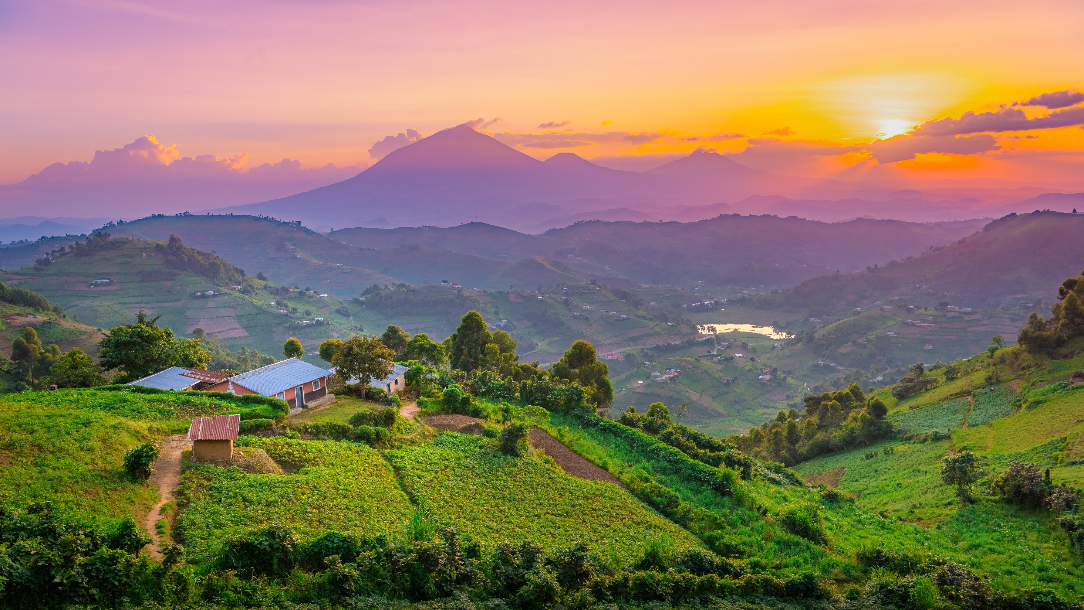
SCENIC
LANDSCAPE
&
MOUNTAINS

Slide 14
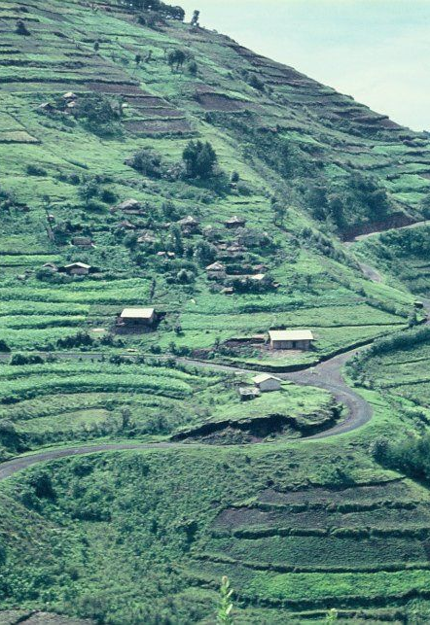
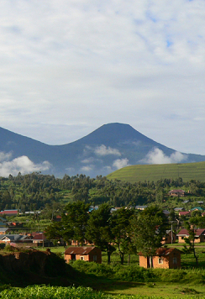
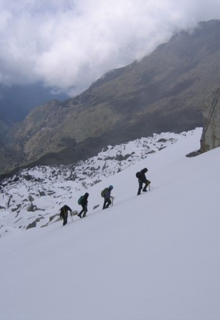
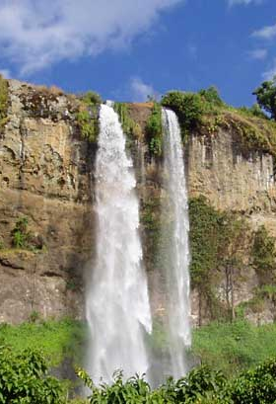
RWENZORI
MOUNTAINS
MT. ELGON
Permanently snow capped, a rare condition in equatorial Africa.
Voted among the top hiking places in Africa and among the top hiking spots in the world
Other interesting mountains for hiking include:- Mt. Elgon (Africa's 17th highest mountain), Mt. Mgahinga, Mt. Muhabura, Mt. Moroto, etc.
.
KIGEZI REGION
VIRUNGA
VOLCANOES
Referred to as the Switzerland of Africa because of its scenic landscape & weather
In south-western Uganda, voted “A must see place for 2012” and among the 12 places one has to visit in their life time

Slide 15
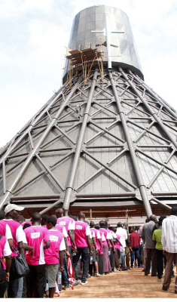
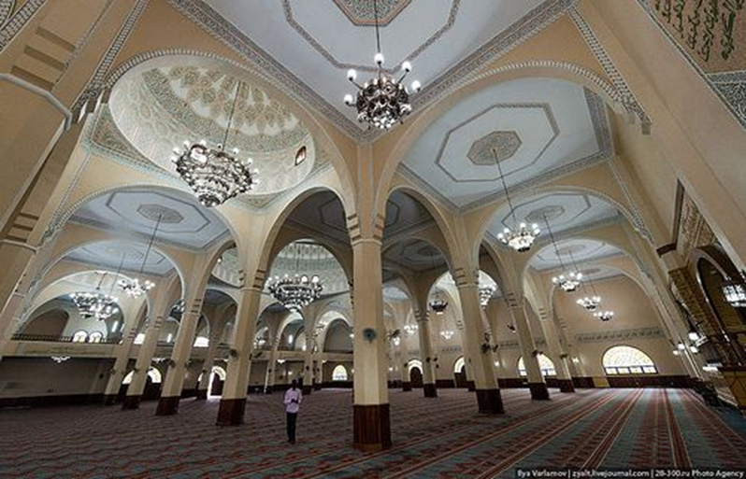
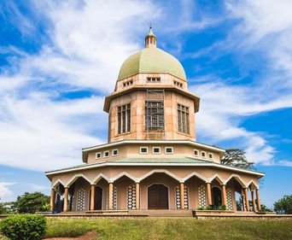
RAPIDLY GROWING FAITH TOURISM
The Bahai temple (for the Bahai faith, and the only one of its kind in Africa) is found in Uganda and it gathers a lot of tourists
The martyrs shrine Namugongo (where 14 Christians were killed by kabaka Mwanga in 1886 for failure to renounce their faith) attracts thousands of pilgrims every year.

Slide 16
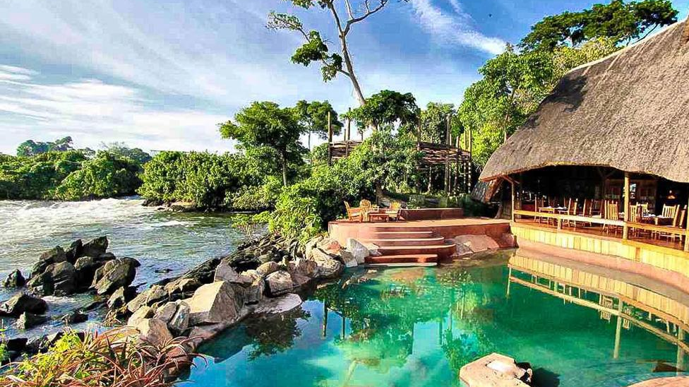
DIVERSE WILDLIFE &
GAME
DIVERSE
CULTURE &
HERITAGE
DIVERSE
CULTURE &
HERITAGE
ACCOMMODATION
SECTOR
ACCOMMODATION
& OTHER ACTIVITIES

Slide 17

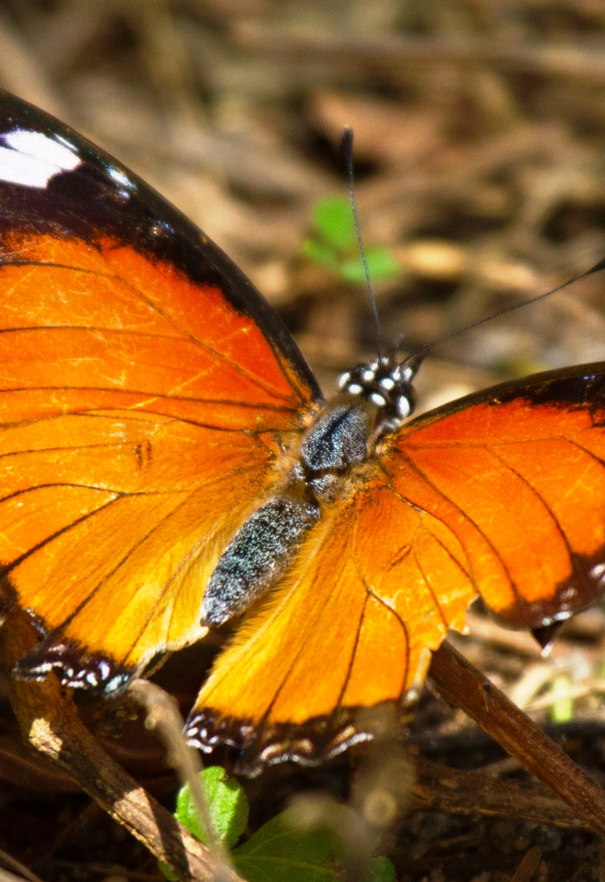
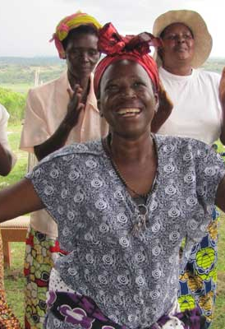

COMMUNITY TOURISM
SHOPPING
BUTTERFLY
WATCHING
AGRO TOURISM

Slide 18
